Slide 1
Auto
encoder
By: Marcus Blea

Slide 2
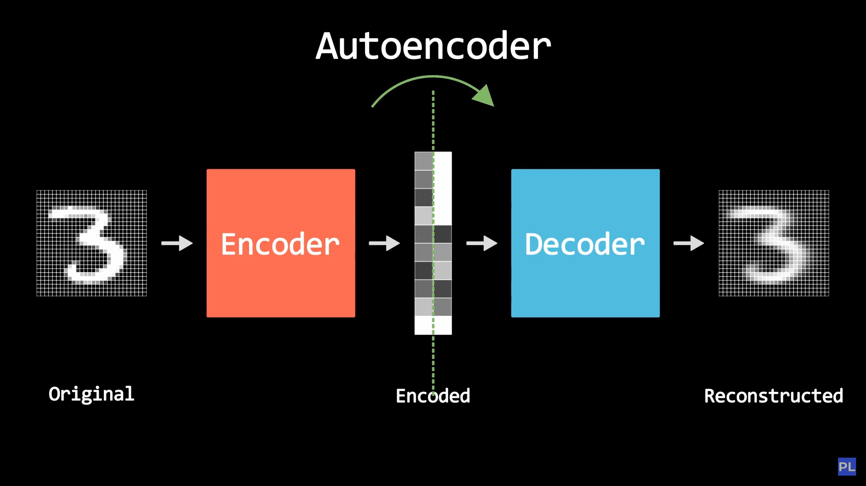
What is an AutoEncoder?
An autoencoder is a neural network that learns efficient data representations by encoding the input into a lower-dimensional latent space and then decoding it back to reconstruct the original input.

Slide 3
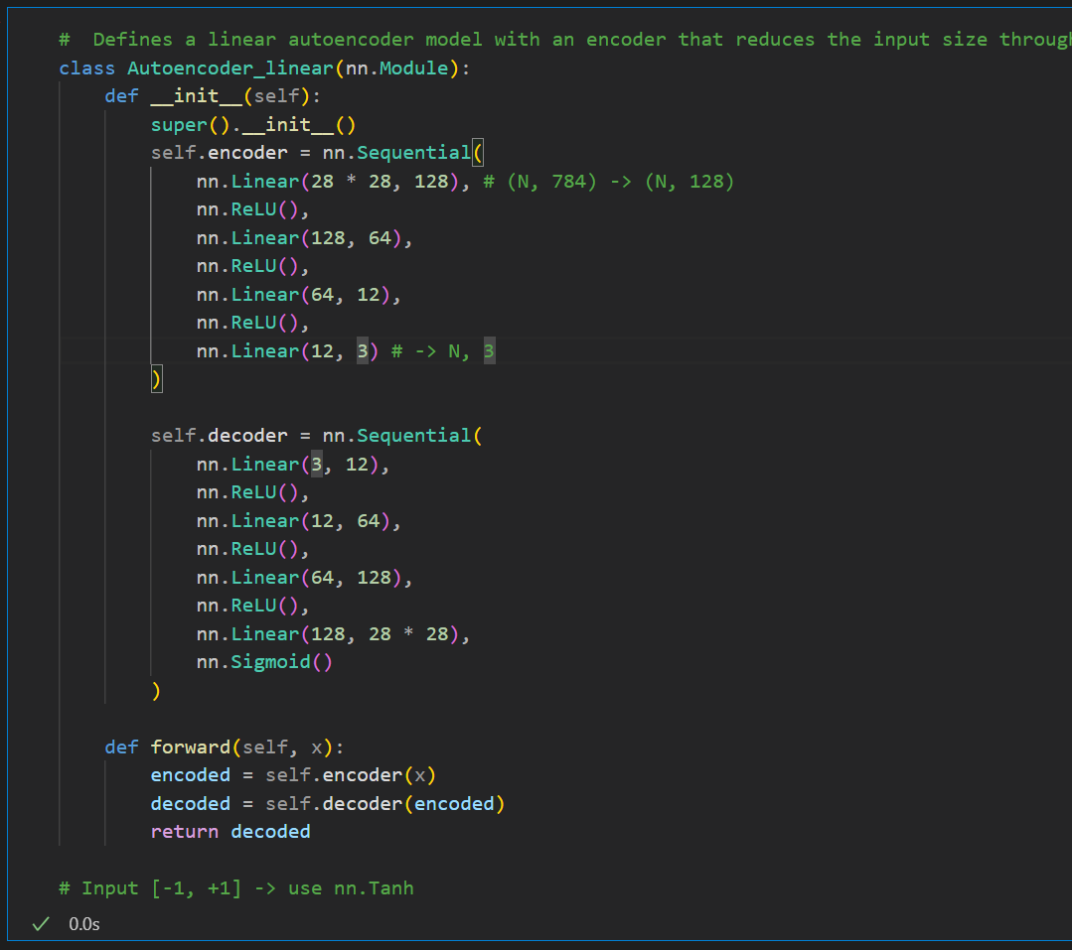
Linear Autoencoder
A type of autoencoder that uses only linear transformations in its encoder and decoder to learn a lower-dimensional linear representation of the input data

Slide 4
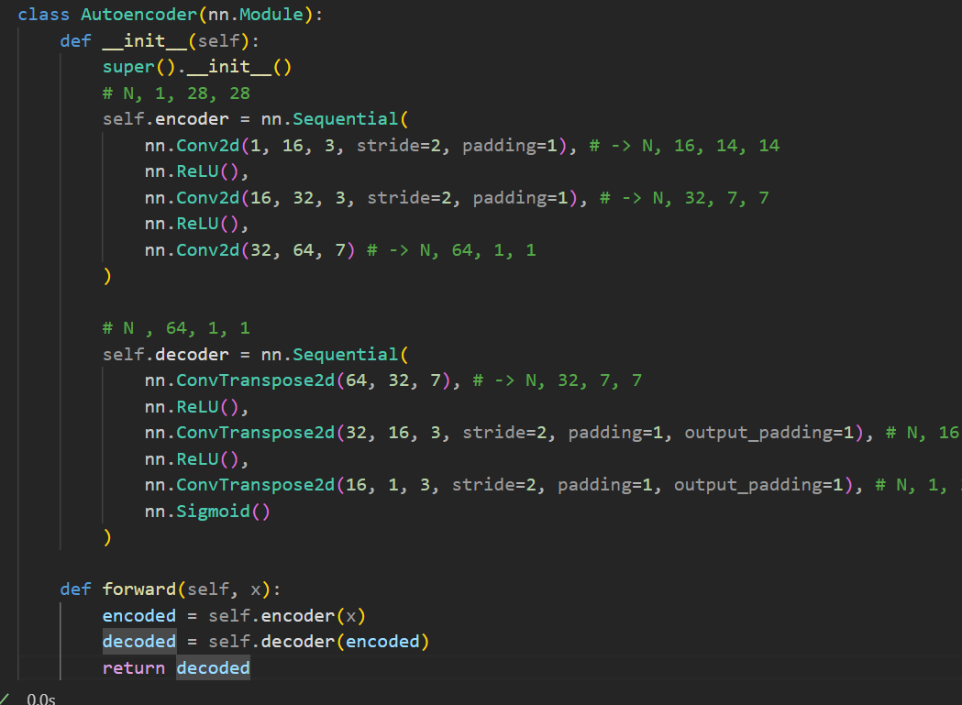
Convolutional Autoencoder
Employs convolutional layers in its encoder to learn spatial hierarchies of features and transpose convolutional layers in its decoder to reconstruct the input from a compressed representation.

Slide 5
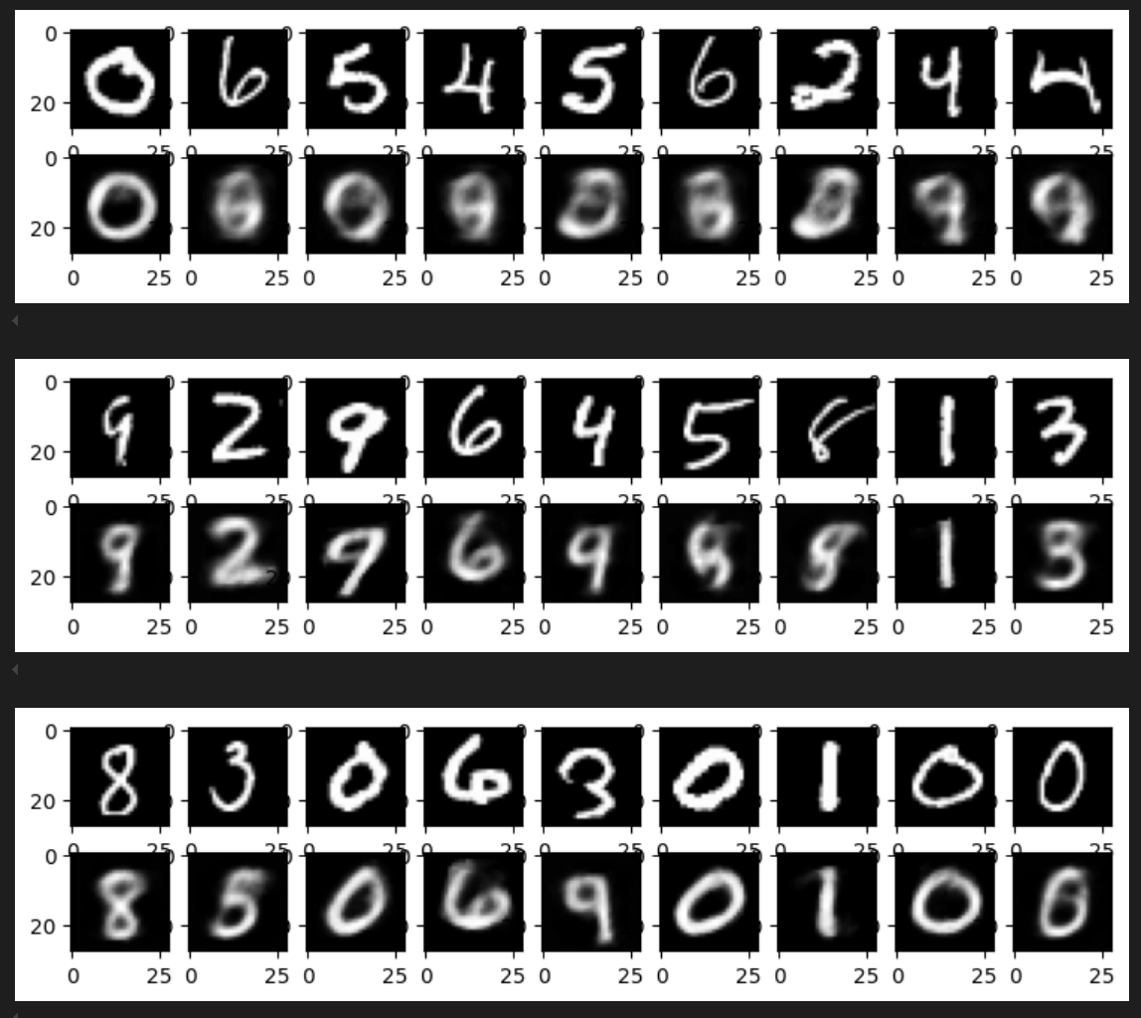
What is the point of these examples?
It tries to learn a compressed representation of an input so that i can be used to reconstruct the original input

Slide 6
Lets look
At the
Code!

Slide 7
Thank
You!

